Slide 1
The geography of higher education access and participation
Chris Millward
Director for Fair Access and Participation, OfS
5 July 2018

Slide 2

The social mobility challenge
‘In our country today, where you start still all too often determines where you finish. And while talent is spread evenly across the country, opportunity is not. None of us should accept this. Everyone deserves a fair shot in life and a chance to go as far as their hard work and talent can take them.’

Slide 3
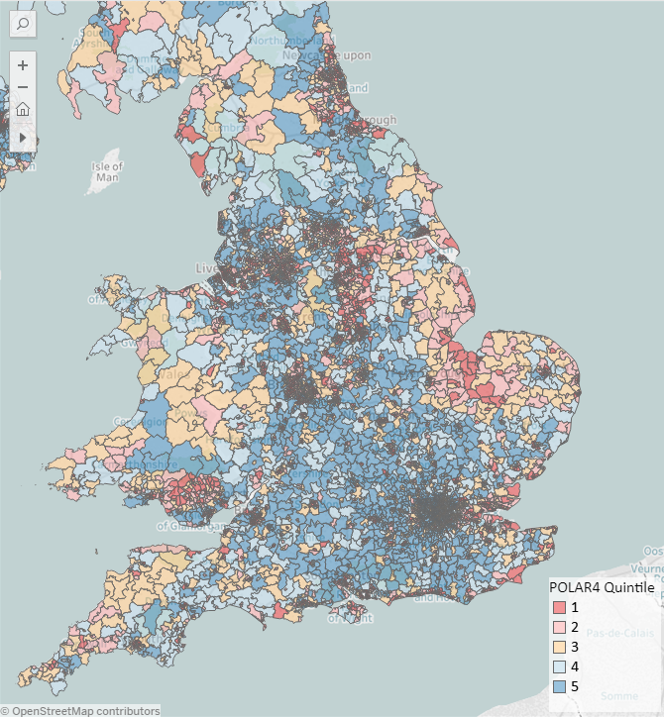
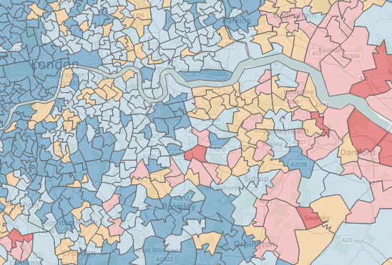
HE participation varies across the country
POLAR classifies small areas into five quintiles that reflect young participation rates across the UK. London generally has very high levels of participation but pockets such as some parts of Greenwich have lower participation.
https://www.officeforstudents.org.uk/data-and-analysis/polar-participation-of-local-areas/
Notes:
There are different levels of HE participation in different parts of the country

Slide 4
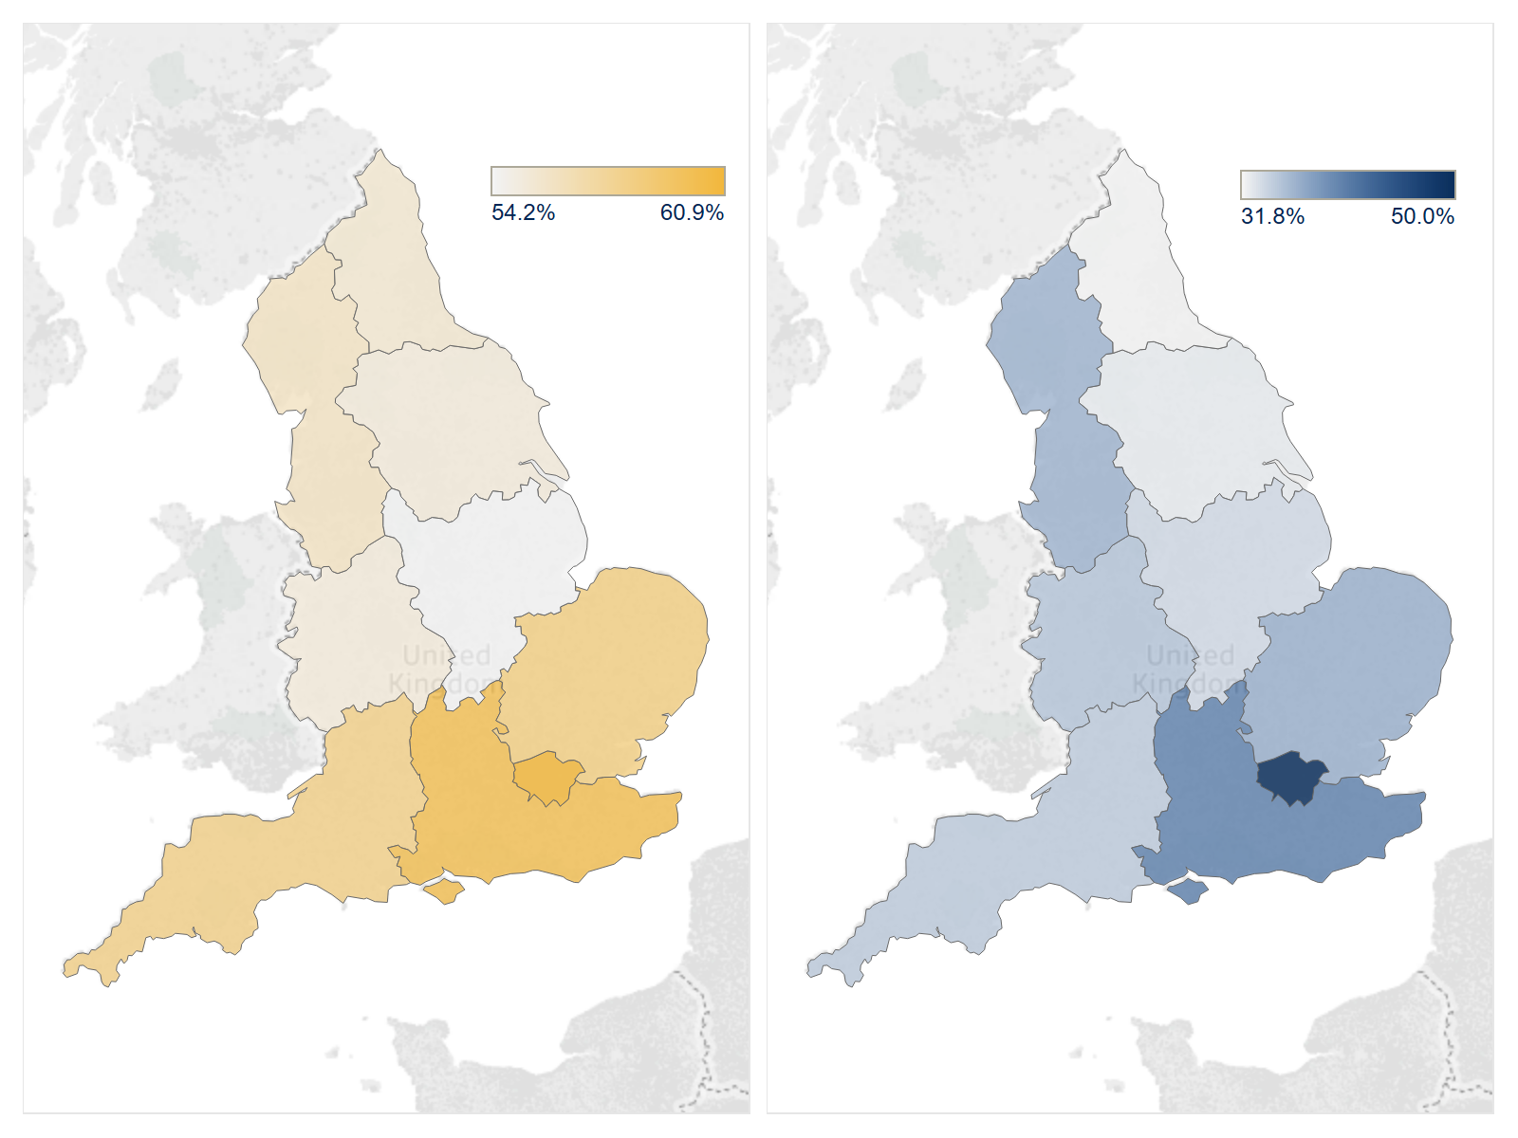
Academic attainment before HE is a key factor
Proportion of KS4 pupils attaining 5+ A* to C grades at GCSE including English and Maths (2014-15)
Young participation rate for cohorts who were 18 at the start of the academic years 2009-10 to 2013-14
https://www.gov.uk/government/statistics/revised-gcse-and-equivalent-results-in-england-2014-to-2015
https://www.officeforstudents.org.uk/data-and-analysis/polar-participation-of-local-areas/polar4-data/
Notes:
We know that academic attainment before HE is a key factor
KS4 statistics
https://www.gov.uk/government/statistics/revised-gcse-and-equivalent-results-in-england-2014-to-2015
Young participation rates derived from combined entrant and population statistics (msoa to NUTS1 regions)
https://www.officeforstudents.org.uk/data-and-analysis/polar-participation-of-local-areas/polar4-data/

Slide 5
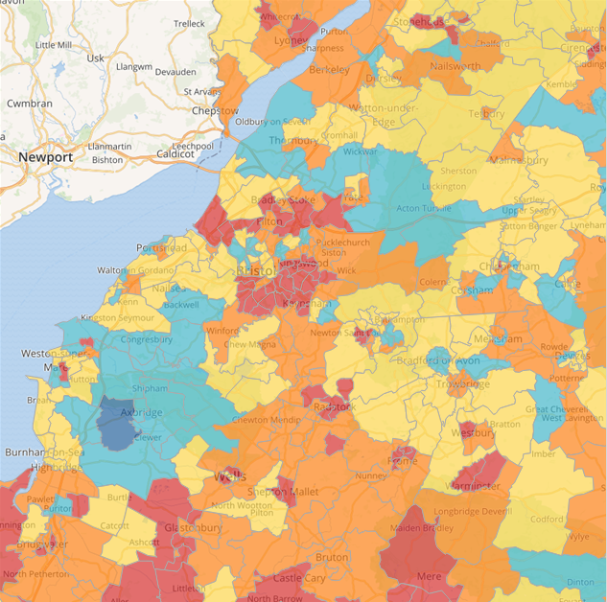
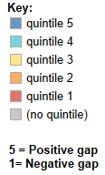
But gaps persist even once attainment is taken into account
Accounting for GCSE attainment
Source: Hefce
http://www.hefce.ac.uk/analysis/yp/gaps/
Notes:
And we know that there are gaps in participation between local areas even once you take attainment into account
http://www.hefce.ac.uk/analysis/yp/gaps/

Slide 6
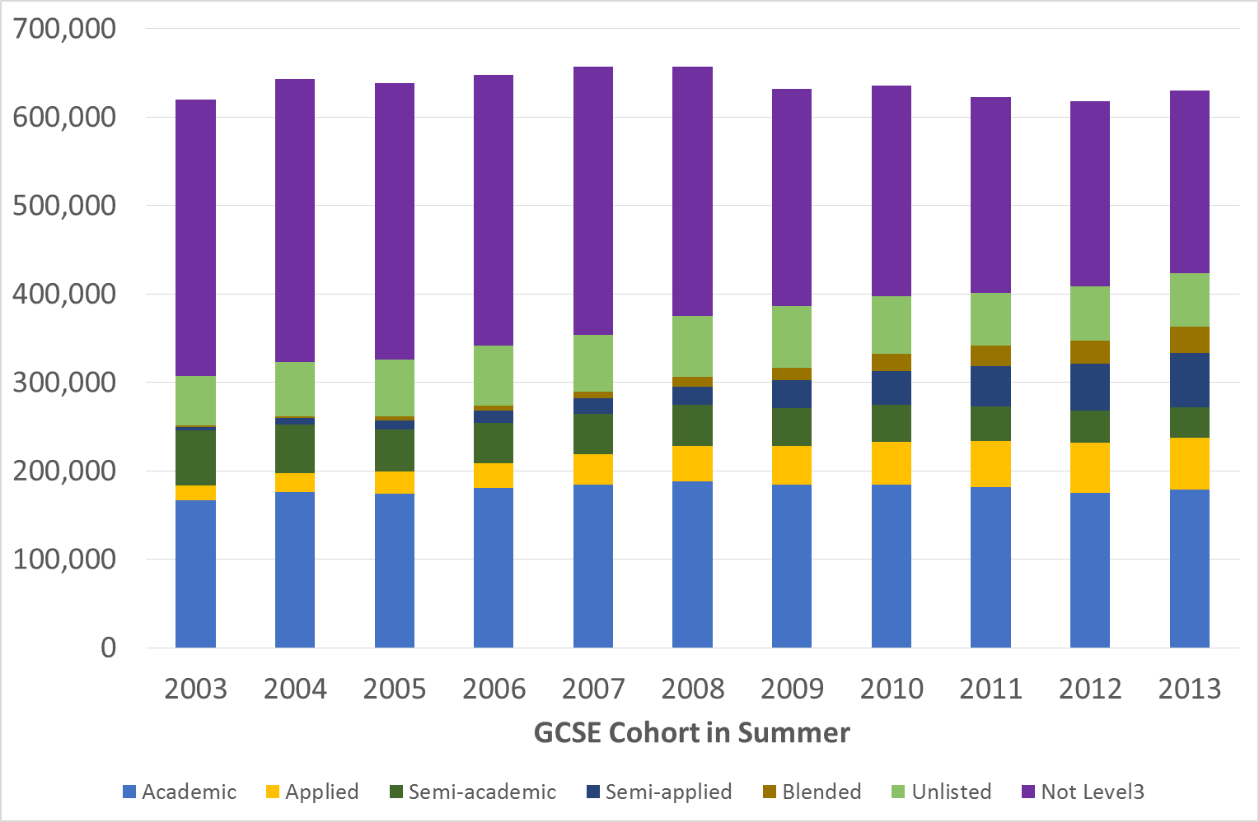
Key stage 5 pathways have been changing
The proportion not attaining level 3 has been shrinking
Growth has come from Applied, Semi-Applied and Blended qualification types
No change in proportion following academic route
OfS analysis of data sourced from the Department for Education’s National Pupil Database. See note on slide 19
Notes:
But we know also that whether you follow an academic or a vocational route, or indeed no route at all, has an impact

Slide 7
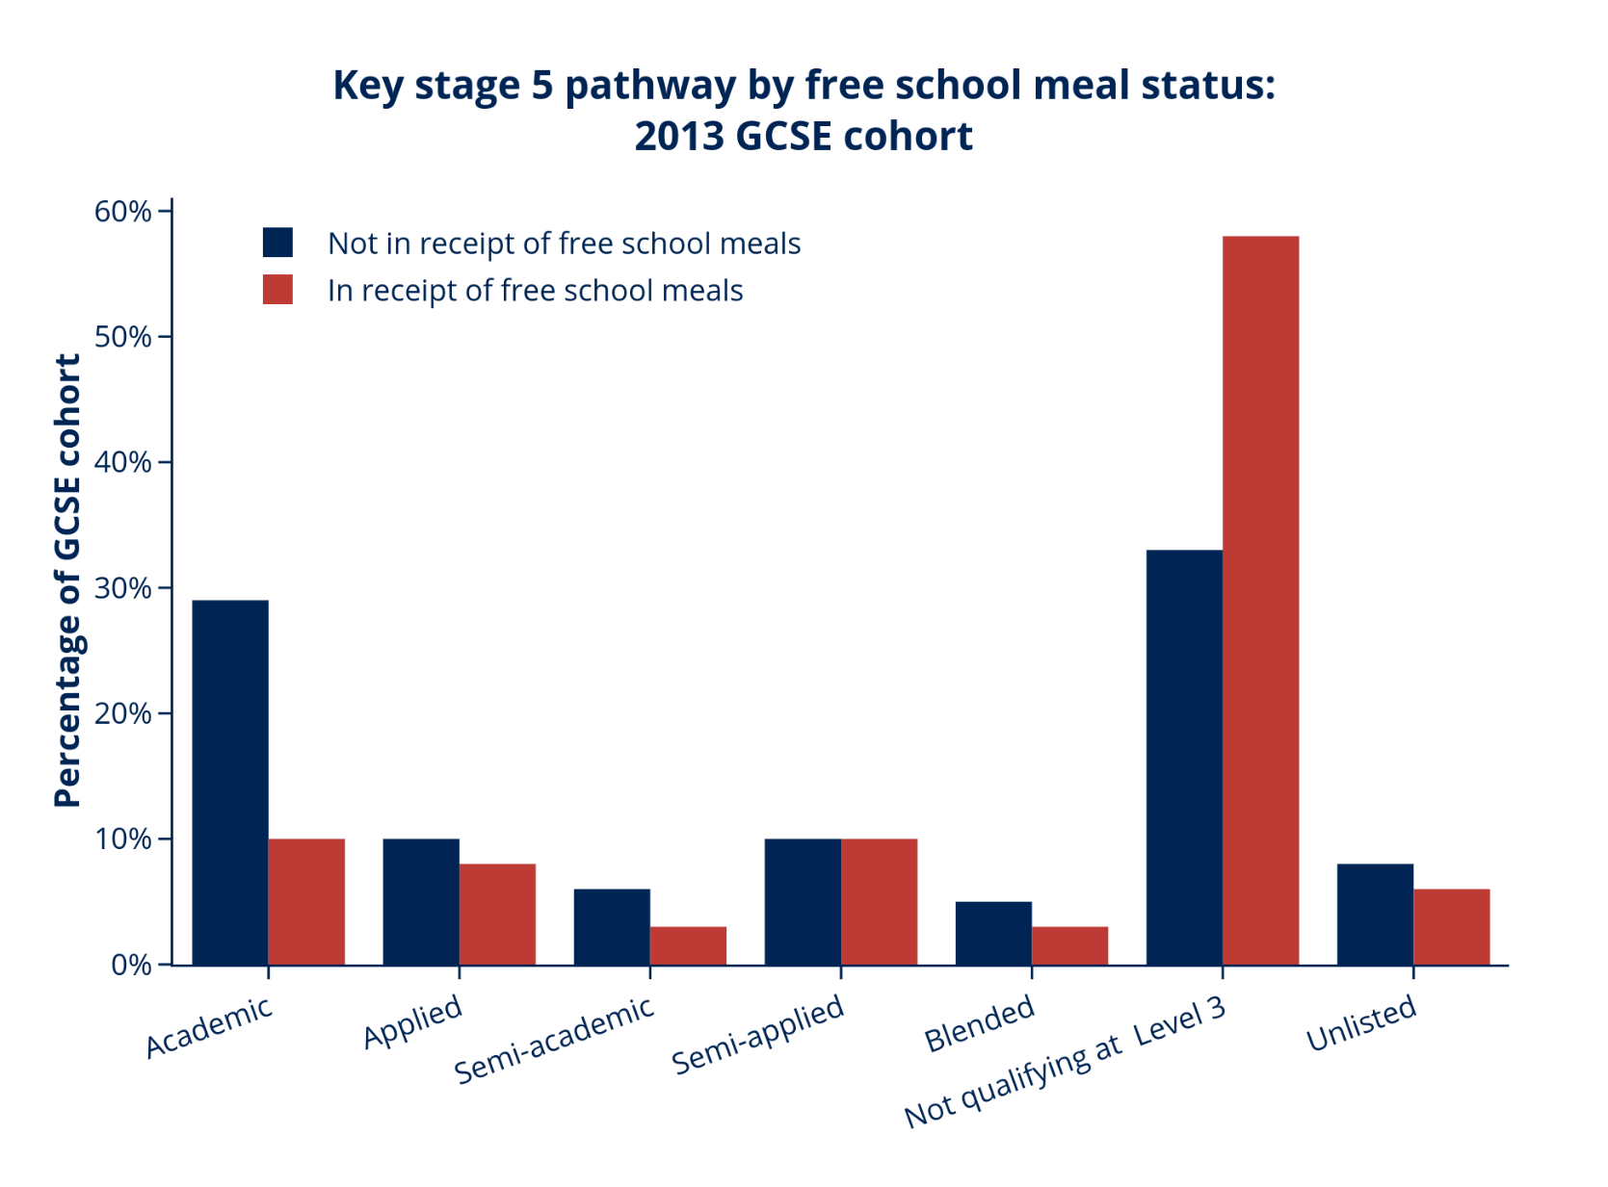
Those pathways vary by background
OfS analysis of data sourced from the Department for Education’s National Pupil Database. See note on slide 19
Notes:
But we know also that whether you follow an academic or a vocational route, or indeed no route at all, has an impact (chart / data)

Slide 8
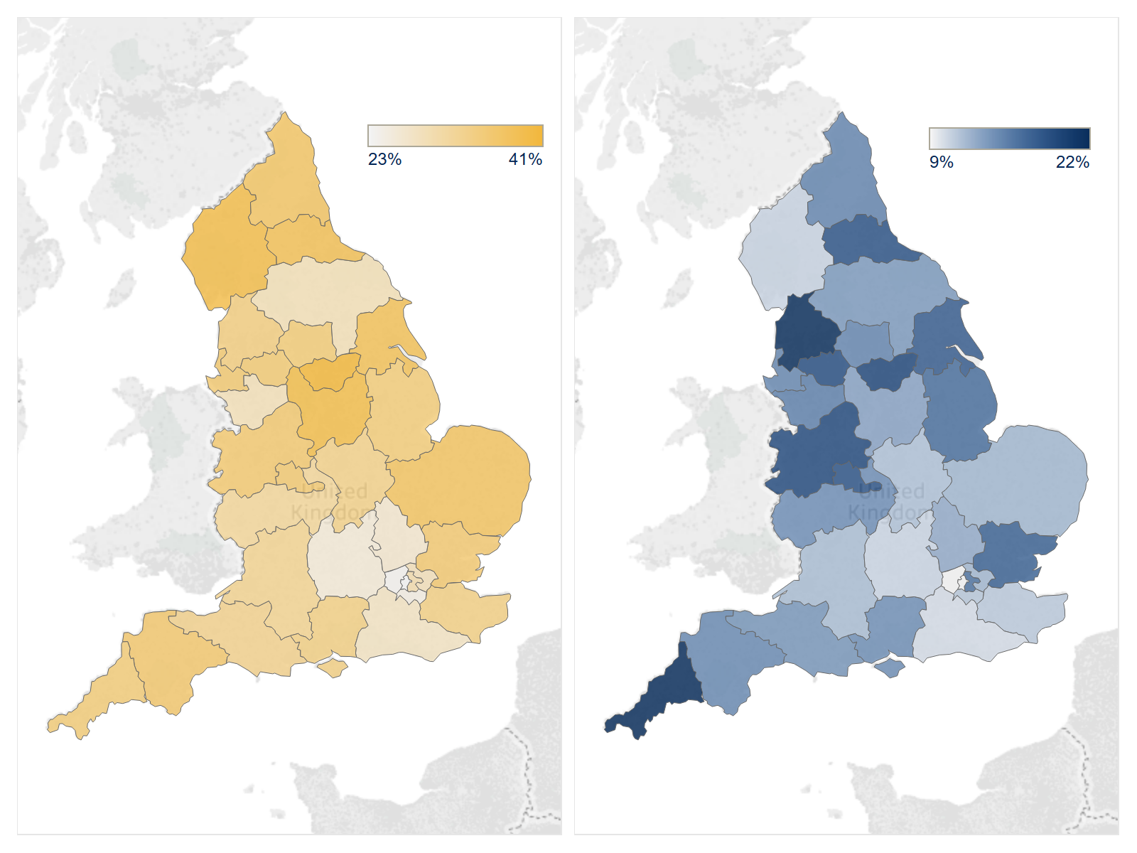
And by geography
Proportion of 2013 GCSE cohort not progressing to Key Stage 5 / A-Level
Proportion of Key Stage 5 progressors studying for BTECs (Level 3)
OfS analysis of data sourced from the Department for Education’s National Pupil Database. See note on slide 19
Notes:
But we know also that whether you follow an academic or a vocational route, or indeed no route at all, has an impact

Slide 9
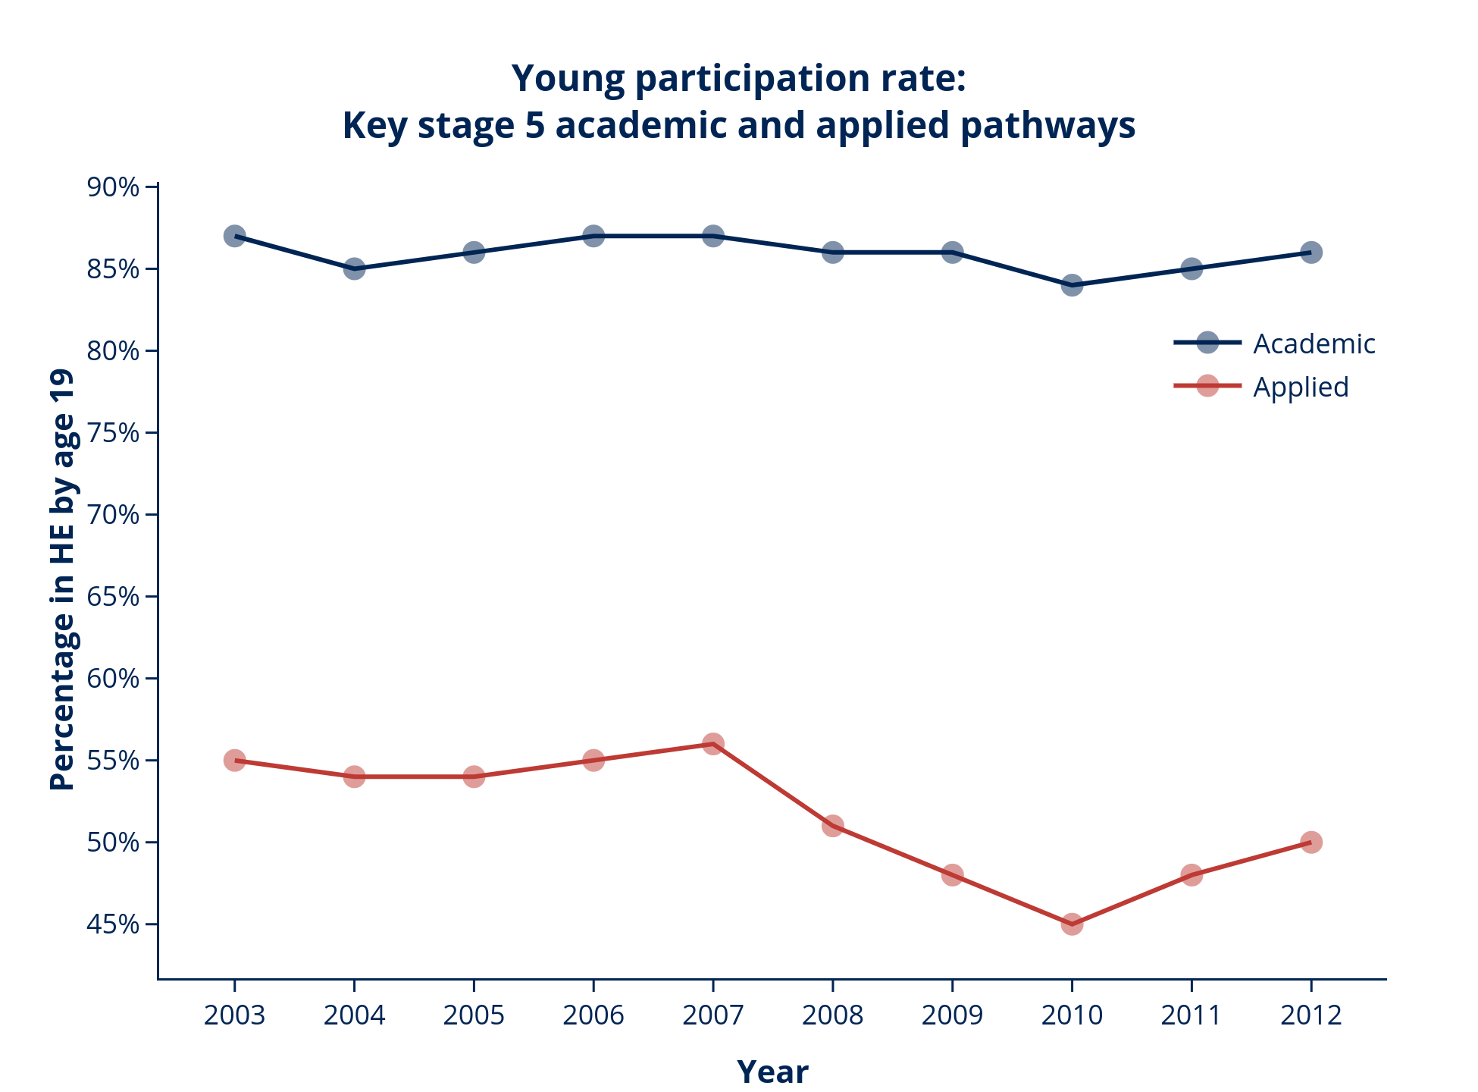
This can affect access to HE
OfS analysis of data sourced from the Department for Education’s National Pupil Database. See note on slide 19. Linked to HESA student record

Slide 10
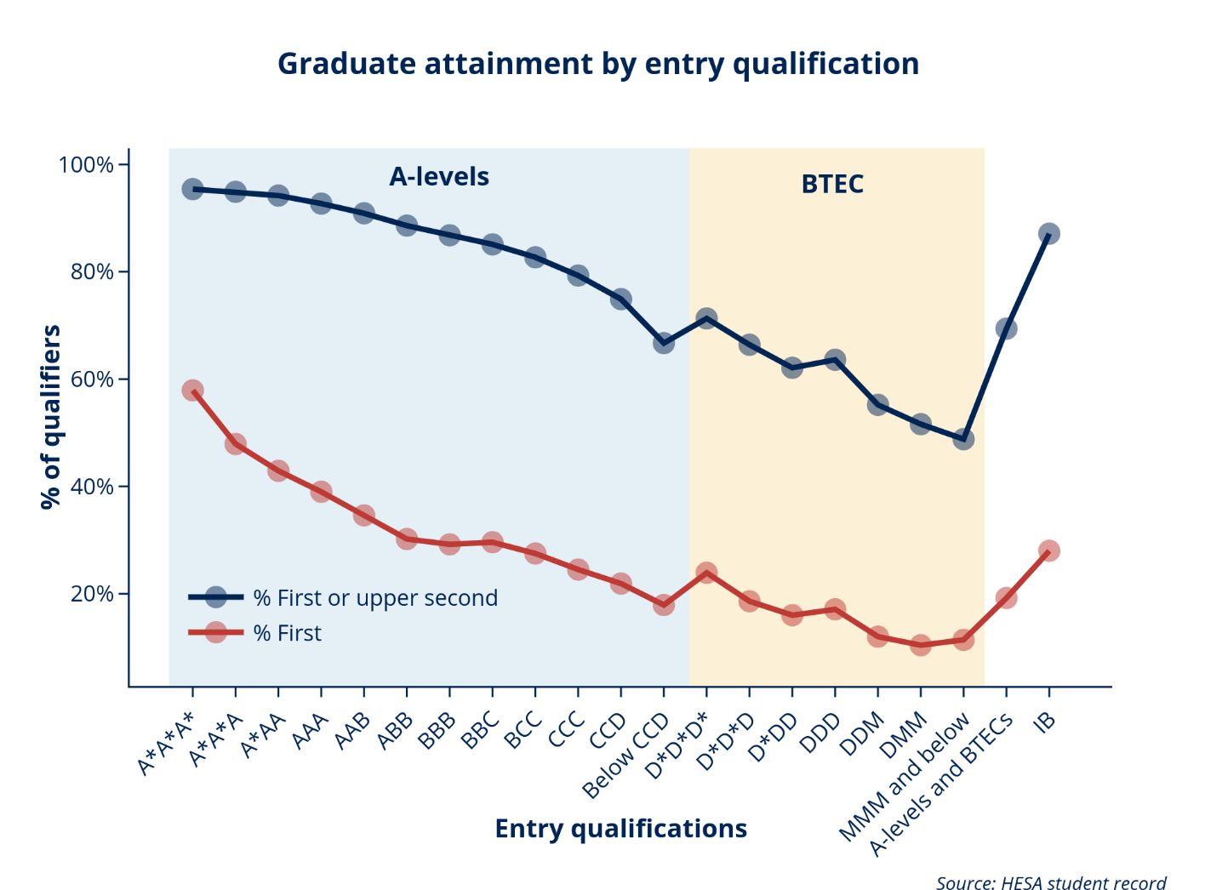
And it can affect student success
Degree success depends on level and type of entry qualifications
https://www.officeforstudents.org.uk/data-and-analysis/differences-in-student-outcomes/degree-outcomes-overview/
Notes:
Factors we have identified as influential for HE access also affect student success, notably:
Attainment
Whether you enter with academic or vocational qualifications
https://www.officeforstudents.org.uk/data-and-analysis/differences-in-student-outcomes/degree-outcomes-overview/

Slide 11
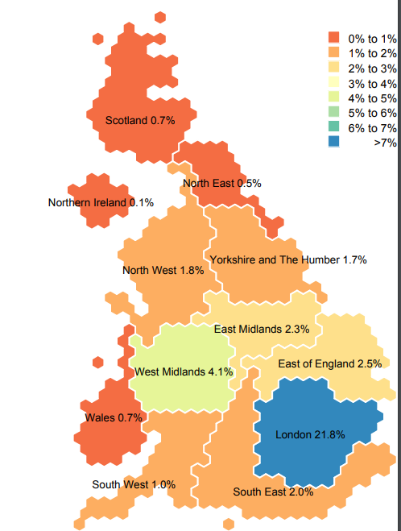
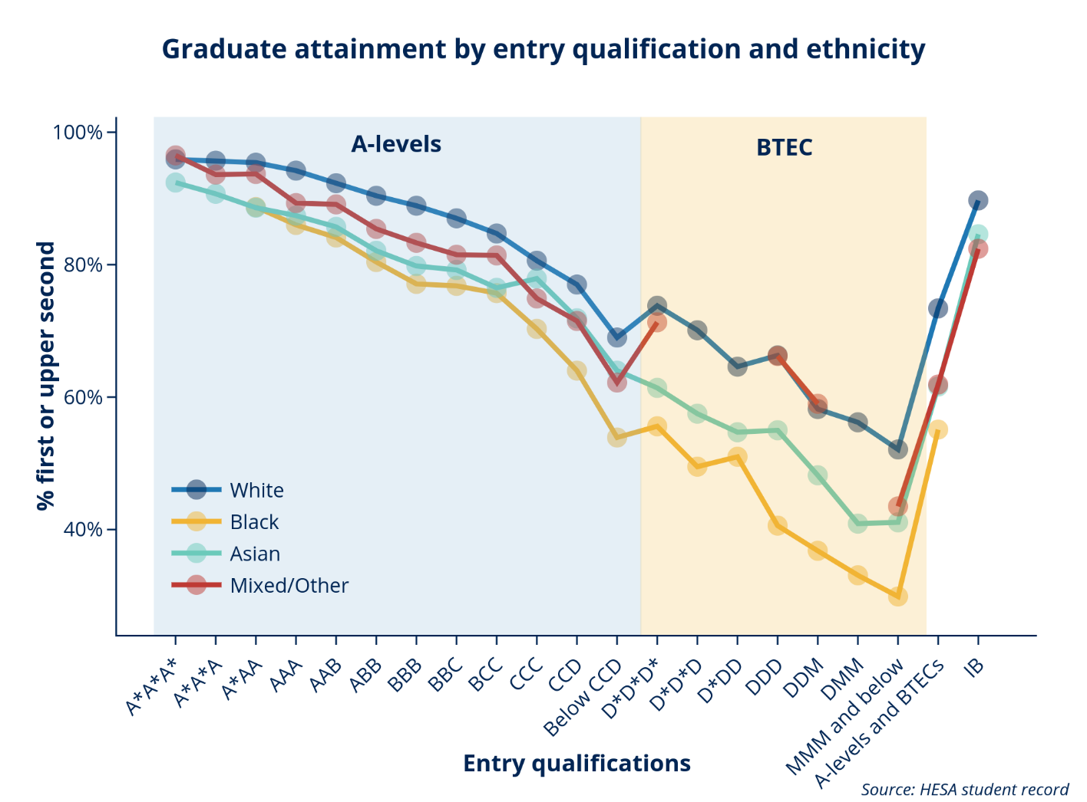
Ethnicity of the population also varies by geography, and degree outcomes vary by ethnicity
Proportion of the young population from the black ethnic group
https://www.officeforstudents.org.uk/data-and-analysis/differences-in-student-outcomes/ethnicity/
https://www.ucas.com/file/65651/download?token=Sv-zNKMr
Notes:
Factors we have identified as influential for HE access also affect student success, notably:
Attainment
Whether you enter with academic or vocational qualifications
https://www.officeforstudents.org.uk/data-and-analysis/differences-in-student-outcomes/ethnicity/
https://www.ucas.com/file/65651/download?token=Sv-zNKMr
Ethnic group – The population of different ethnic groups is not even across the UK. For example, over 20% of the young population in London is in the Black ethnic group (9.74 KB), compared to 1% in the South West. This can be reflected in the statistics for a university.

Slide 12
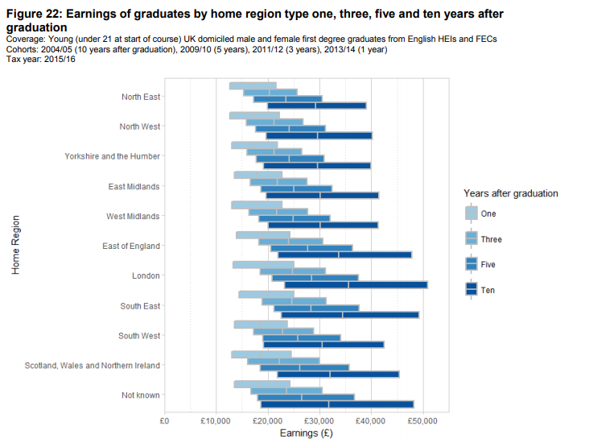
Graduate employment is also influenced by geography
And earnings of graduates vary by their home region
Ten years after graduation the median earnings of graduates originally from London are 20% higher than graduates originally from the North East
Source: DfE https://www.gov.uk/government/statistics/graduate-outcomes-2015-to-2016
Notes:
https://www.gov.uk/government/statistics/graduate-outcomes-2015-to-2016

Slide 13
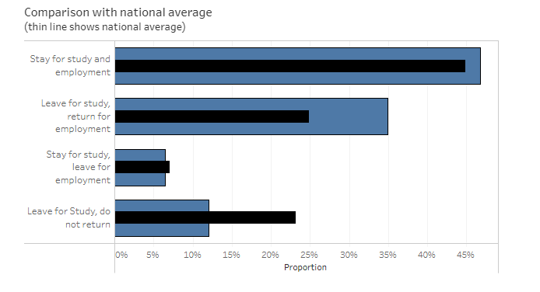
With benefits for students who can work in areas of high productivity and growth
Students from London are more likely to leave for study and then return for employment than the national average
http://www.hefce.ac.uk/analysis/maps/mobility/mobdata/
Notes:
Where you study and where you go on to work also affects your employment beyond HE
http://www.hefce.ac.uk/analysis/maps/mobility/mobdata/

Slide 14
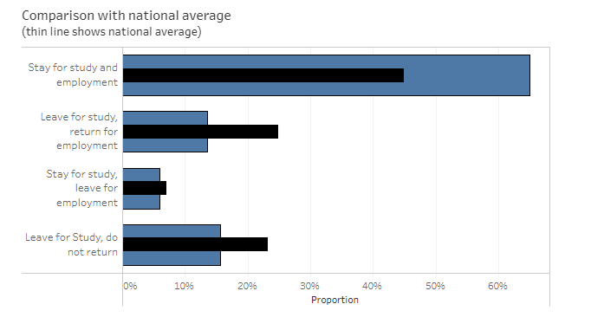
But real challenges for those who do not
Those from the North East are much more likely to stay in the region for both study and employment
http://www.hefce.ac.uk/analysis/maps/mobility/mobdata/
Notes:
Where you study and where you go on to work also affects your employment beyond HE
http://www.hefce.ac.uk/analysis/maps/mobility/mobdata/

Slide 15
What should we do to address this?
Strategic and sustained work to:
engage with local communities, schools and colleges on expectations, pathways and attainment before HE
recognise background within admissions and support transition into HE
develop skills and attributes for employment and absorptive capacity for graduates in local areas

Slide 16
What is the Office for Students going to do (1)?
Pressure for individual universities and colleges to:
demonstrate continuous, year-on-year improvement through their access and participation plans by:
    reducing the gaps in access, success and progression for underrepresented groups among their own students
    improve practice, including through better evaluation and sustained engagement with schools from early years and with employers.

Slide 17
What is the Office for Students going to do (2)?
Sector-wide support for:
availability and use of more common and rigorous data and evidence to target and evaluate access and participation work
collaborative working between different universities and colleges and with schools and employers, e.g. NCOP
advancement and sharing of innovative and effective practice, e.g. Barriers to Student Success

Slide 18
How to find out more
Email chris.millward@officeforstudents.org.uk
Twitter @officestudents
Website www.officeforstudents.org.uk
monthly e-newsletter
OfS alerts
OfS alerts for the Prevent duty
OfS alerts for charity regulation
You can join these at;
https://www.officeforstudents.org.uk/sign-up-for-email-alerts

Slide 19
Slides 6,7,8 and 9 contain analysis created from data sourced from the Department for Education’s National Pupil Database. The DfE does not accept responsibility for any inferences or conclusions derived from the NPD data by third parties.
Copyright ©
The copyright in this presentation is held either by the Office for Students (OfS) or by the originating authors.
Please contact info@officeforstudents.org.uk for further information and re-use requests.

